Slide 1

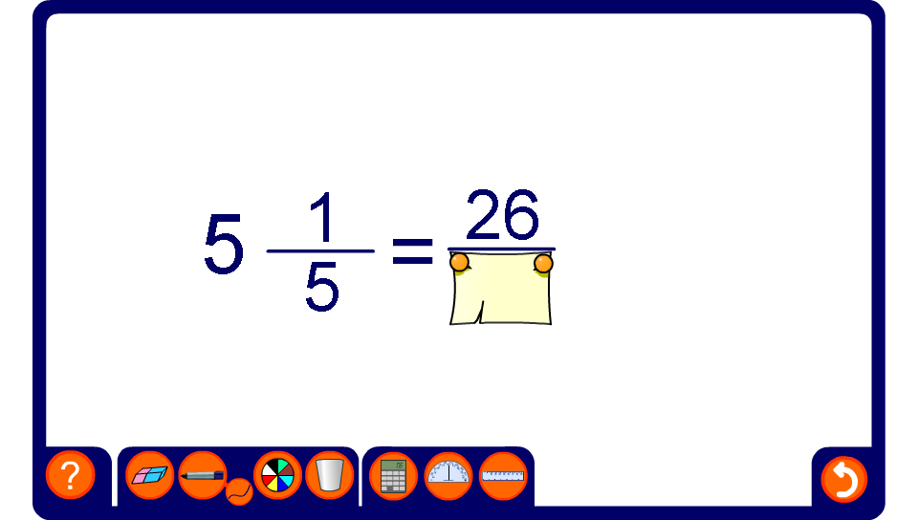


Find the missing number
Notes:
In this activity equivalent fractions, mixed numbers and improper fraction are generated.
Ask pupils to find the value of the missing number, explaining their reasoning.

